Slide 1
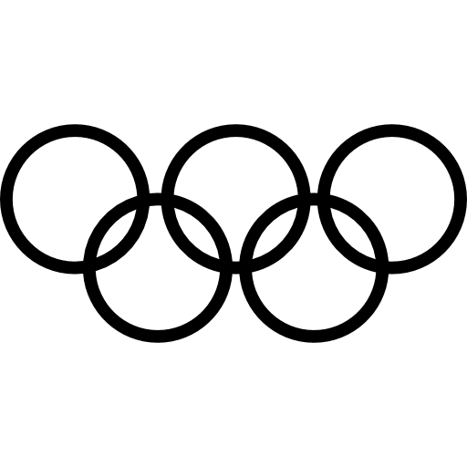


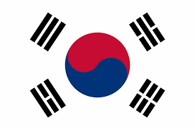

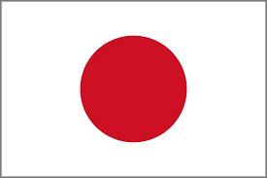

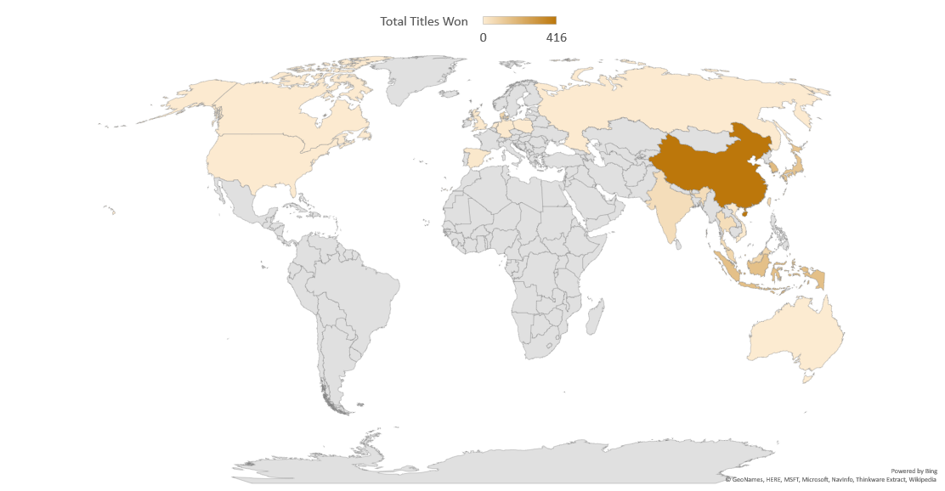

Who
over the
REIGNED
Last Decade?
#Trophies
416
168
154
135
80
22
107
10
252
Winning
Nationalities
Represented Countries/Regions
Years
Tournaments
Held
Notes:
22 Winning nationalities (from)
107 represented countries/regions (over)
10 years

Slide 2

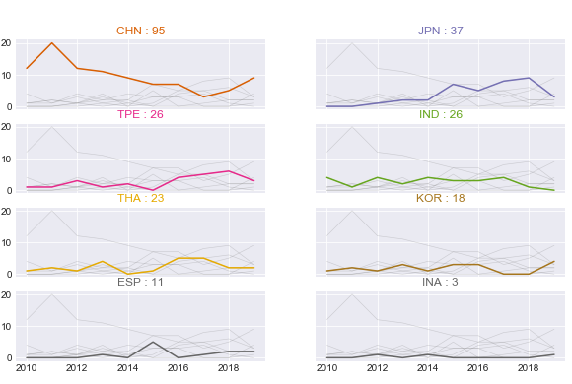

Women’s Singles
8 Top Performing Countries in Women’s Singles
Total Tournaments Won
In Women’s Singles, for the first half of the decade, China showed its domination but later declining.
Nevertheless, Japan started to rise since 2014. Japan took the share and won most of the tournaments in 2017 and 2018.
Spain has also won 11 titles in the last decade, making them the most winning countries in this sector from Europe.
Year

Slide 3

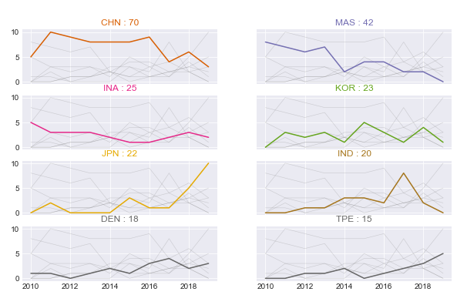

Men’s Singles
8 Top Performing Countries in Men’s Singles
Total Tournaments Won
China showed their dominance, followed by Malaysia in Men’s Singles.
Other interesting point is that, we can see the steep incline by Japan in Men’s Singles since 2017. Besides Japan, Chinese Taipei’s performance also has been rising since 2018.
Year

Slide 4

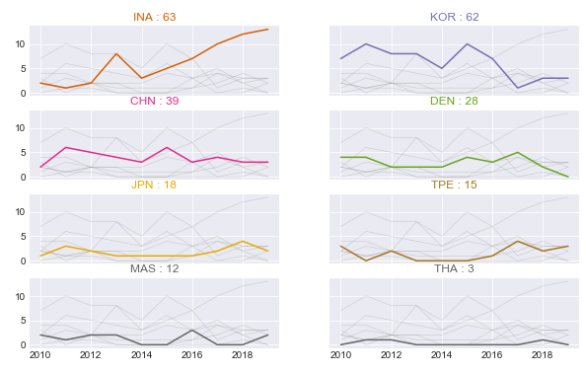

Men’s Doubles
8 Top Performing Countries in Men’s Doubles
Total Tournaments Won
Year
Meanwhile in Men’s Doubles, Korean dominated the sector until 2015, and its position was taken over by Indonesia, which from 2014 has continuously accumulating their number of won tournaments.
China consistently bagged at least 3 trophies every year in the last decade.

Slide 5

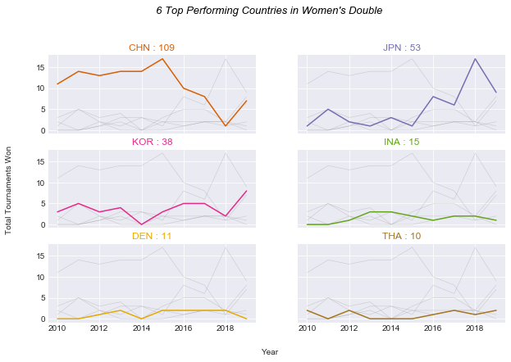

Women’s Doubles
6 Top Performing Countries in Women’s Doubles
Total Tournaments Won
Year
Women’s Doubles also experiences
change in domination. China at first majored in most tournaments, but the three pairs of Japan’s Women Doubles turned the table around in 2018.
We can also see Korea also started to show their rising performance in this
sector since 2018.

Slide 6


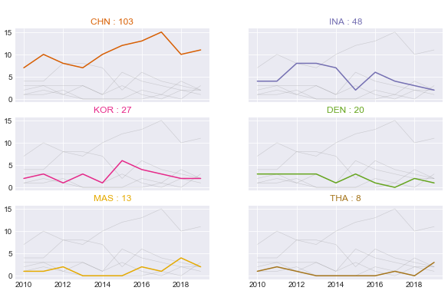
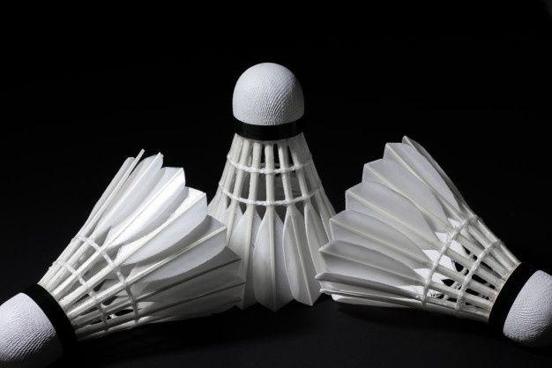
Mixed Doubles
Once again, China topped this sector, followed by Indonesia. Average number of trophies China has brought home is higher than any country (±10).
Last year, China brought 11 titles home. Other top countries outside China each took less than 5 trophies.
6 Top Performing Countries in Mixed Doubles
Total Tournaments Won
Year

